Slide 1
Twitter Account Classification
Project Deliverable #2
Group 7
Shivank Agrawal, Ruoheng Du, Yiwen Ge, Yandong Xiang
Notes:
Dataset: https://www.kaggle.com/code/davidmartngutirrez/bots-accounts-eda/input

Slide 2
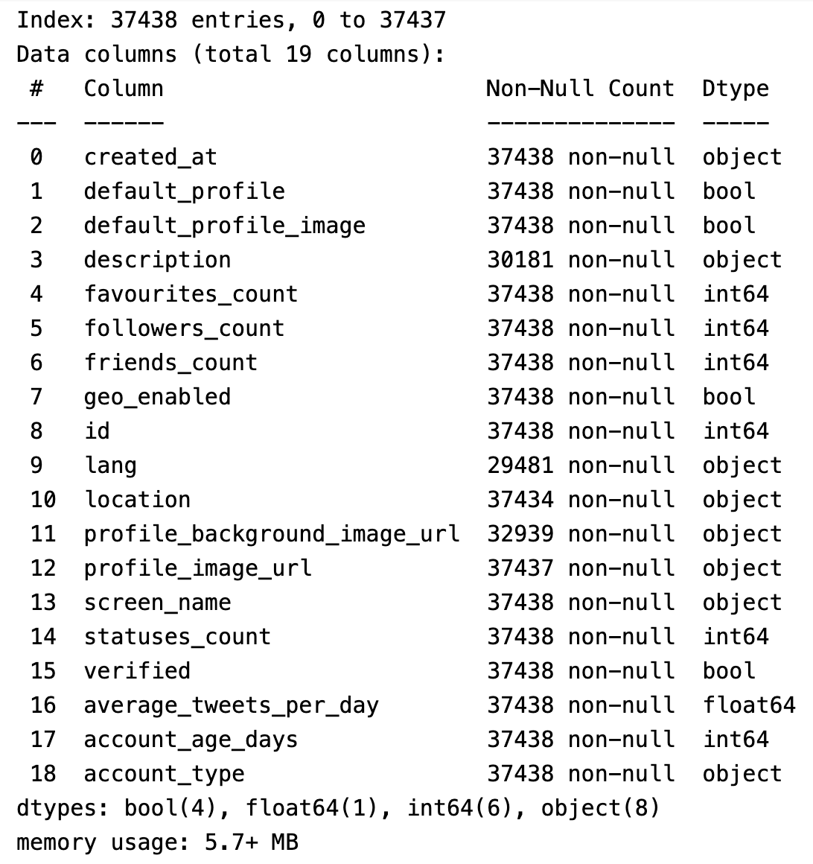
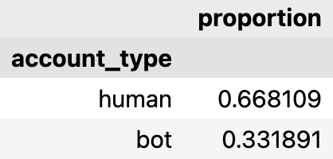
Notes:
Overview: The dataset contains 37,438 entries and 19 columns. Key features include numerical columns such as favourites_count, followers_count, and boolean columns like verified.
Target Distribution: The account_type feature is the target variable, with about 66.8% human accounts and 33.2% bot accounts.

Slide 3
Data Cleaning: Drop Non-informative Features
Dropped Features & Reasons:
created_at: Dropped because account_age_days already captures the account's age, making this column redundant.
profile_background_image_url: Dropped because default_profile already indicates whether the account uses a default background, making the URL unnecessary.
profile_image_url: Dropped because default_profile_image already indicates whether the account uses a default profile image, so the URL adds no extra value.
id: Dropped because it's just a unique identifier with no predictive value for classifying human vs. bot.
screen_name: Dropped because it is a username chosen by the user and doesn't provide meaningful information for classification.
Results: (37438, 14)
Notes:
Purpose of Data Cleaning: Data cleaning helps in reducing the dimensionality of the dataset, which simplifies the model, improves computational efficiency, and avoids overfitting.
Purpose of Dropping Non-informative Features: By dropping non-informative features, we ensure that only the most relevant information is used, which can lead to better model performance and more interpretable results.

Slide 4
Data Cleaning: Handle Missing Values
Features | No. of Missing Values
location | 4
Features | No. of Missing Values
lang | 7957
Features | No. of Missing Values
description | 7257
Action: Removed rows with missing values in the location column.
Rationale: Since only 4 entries had missing values, removing them has a minimal impact on the dataset, simplifying further analysis without significant loss.
Results: (37434, 14)
Action: Filled missing values in the lang column with "Unknown".
Rationale: Analysis showed that accounts with missing language data had a slightly higher proportion of bots (56.5%). Assigning "Unknown" helps the model learn from this pattern, potentially improving classification performance by capturing unique behaviors.
Results: (37434, 14)
Action: Created a new boolean feature, default_description, to indicate whether an account has a description.
Rationale: Accounts without descriptions are more likely to be bots (59.9% bots vs 40.1% humans). This transformation helps simplify the dataset while retaining useful predictive information
Results: (37434, 14)
Notes:
Purpose of Handling Missing Values: Missing values can lead to bias and impact model accuracy if not handled properly. Each strategy was chosen to minimize information loss and improve data quality.
Key Insights:
Removing a small number of entries (location) reduces complexity without major loss.
Imputing missing values (lang and description) helps maintain patterns and ensures that all data can be used effectively during model training.

Slide 5
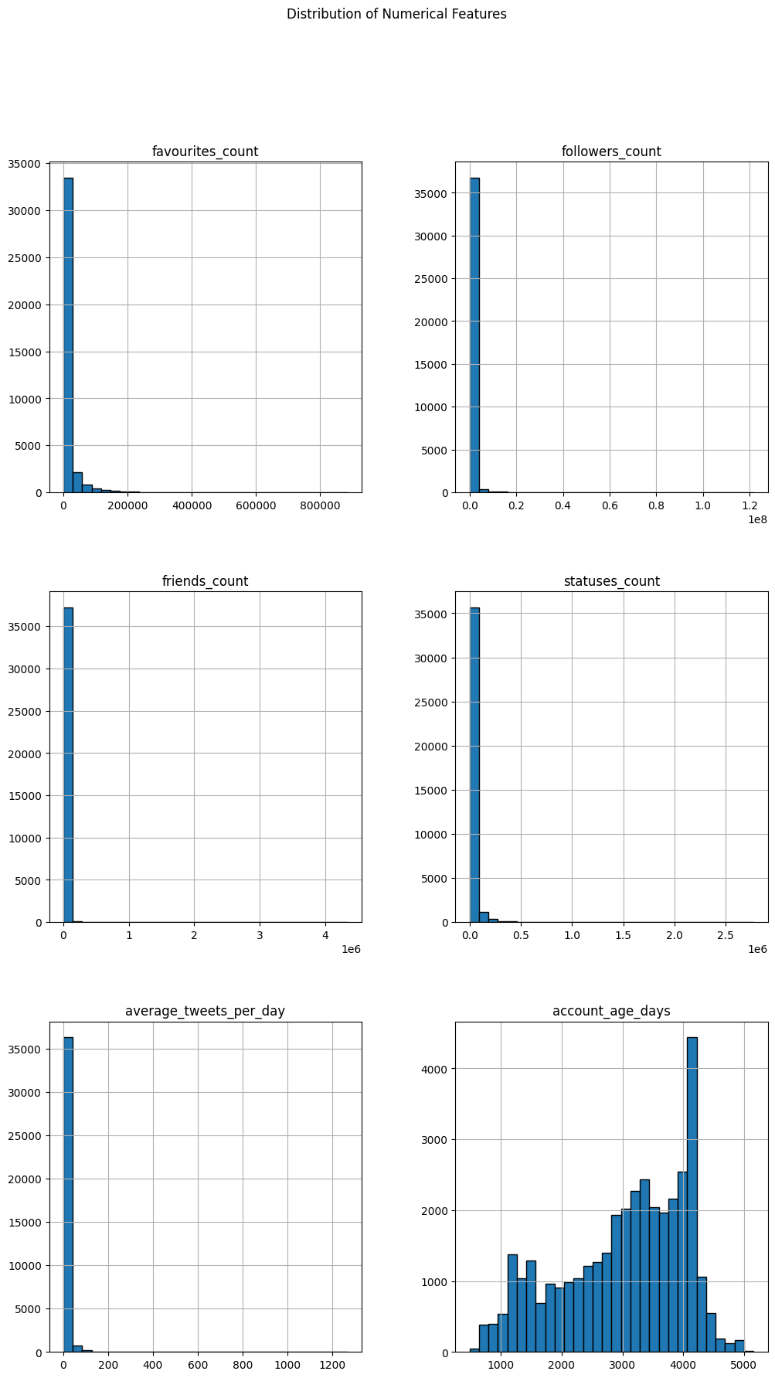
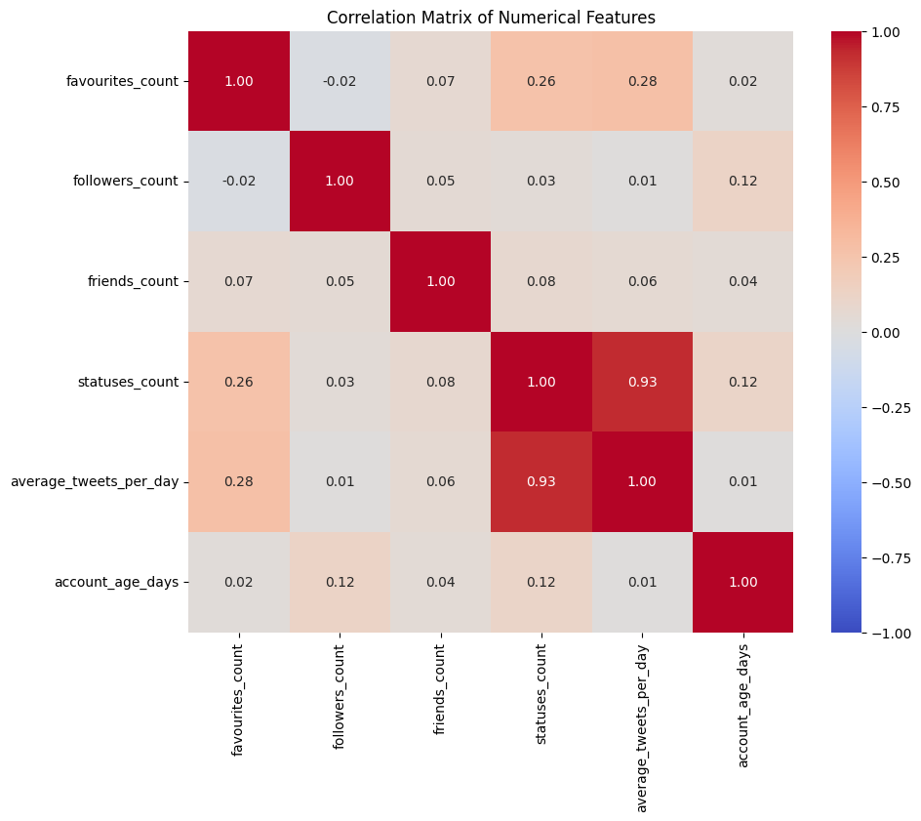
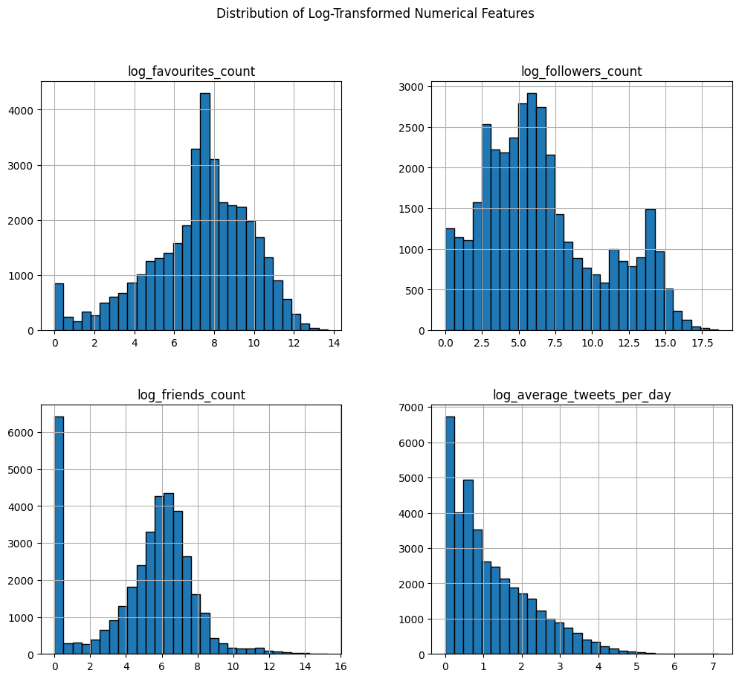
Data Exploration: Numerical Features
Overview of Numerical Features
Correlation Analysis
Handling Skewness
Action: Include the log-transformed versions (favourites_count, followers_count, friends_count, average_tweets_per_day).
Rationale: Analysis showed that histograms of the original features were skewed and the log transformation was applied to bring the distributions closer to normality.
Action: Drop statuses_count column.
Rationale: Analysis showed that statuses_count was highly correlated with average_tweets_per_day and therefore was removed to avoid multicollinearity.
Results: (37434, 13)
Notes:
Handling Skewness: The initial histograms showed that many numerical features were highly skewed, with a long tail due to a few very large values. To address this, we applied a log transformation to features like favourites_count, followers_count, friends_count, and average_tweets_per_day. This transformation helps in reducing the skewness and makes the data more normally distributed, which can improve model performance, especially for models sensitive to feature distributions like linear regression.
Correlation and Feature Selection: After plotting the correlation matrix, we observed a strong correlation between statuses_count and average_tweets_per_day (correlation coefficient > 0.9). To prevent multicollinearity, which could negatively affect the model, we decided to remove statuses_count. This ensures that the model is not overfitting or being influenced by redundant information.
Purpose: By reducing skewness and handling correlated features, we aim to achieve better generalizability and robustness in the subsequent models.

Slide 6
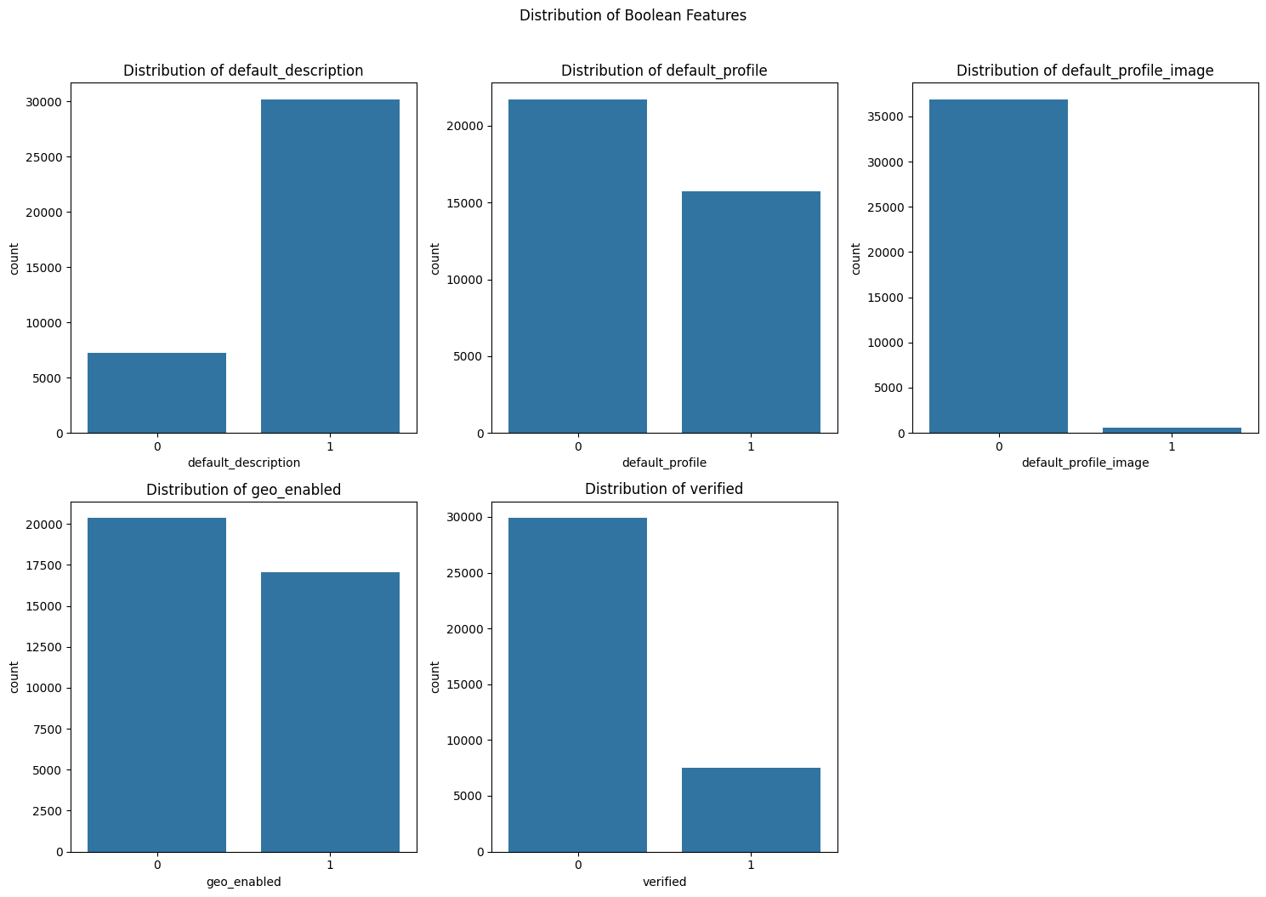
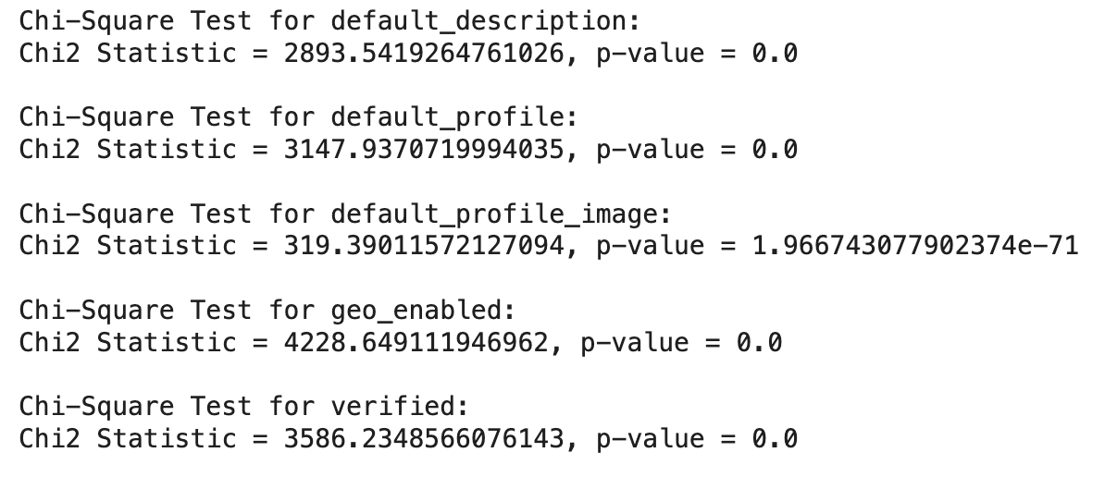
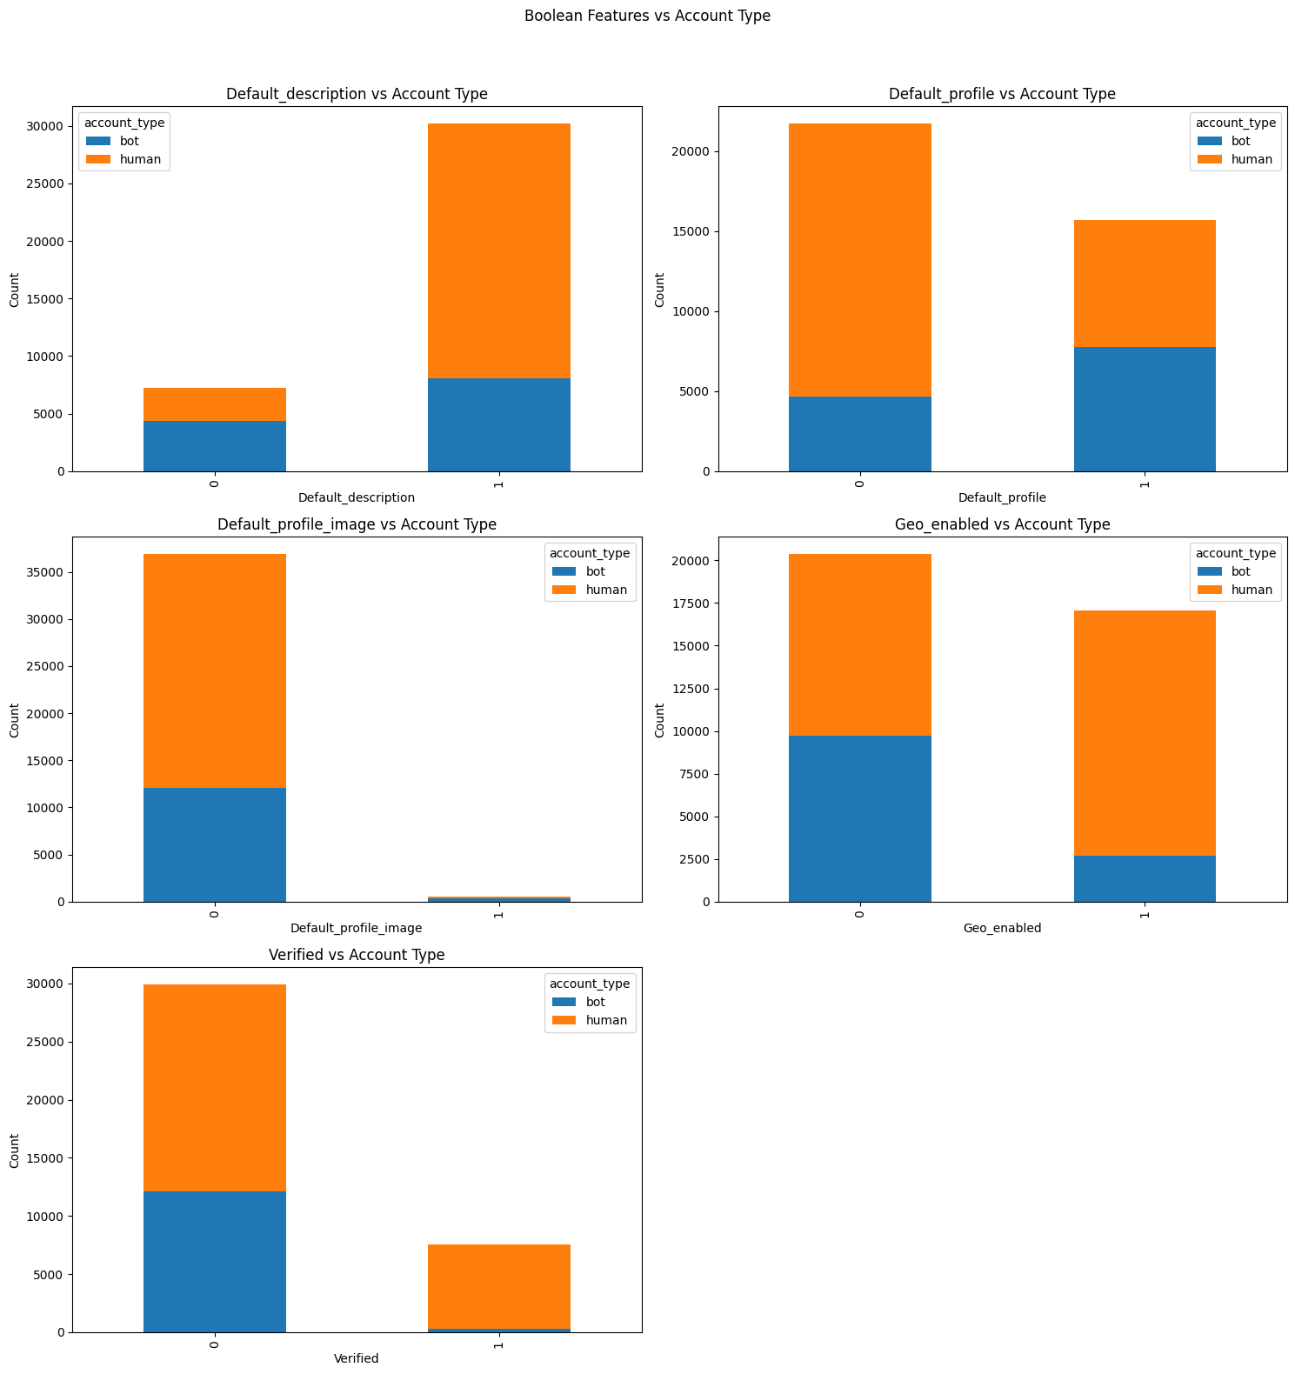
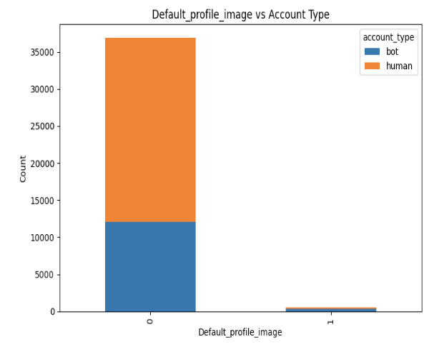
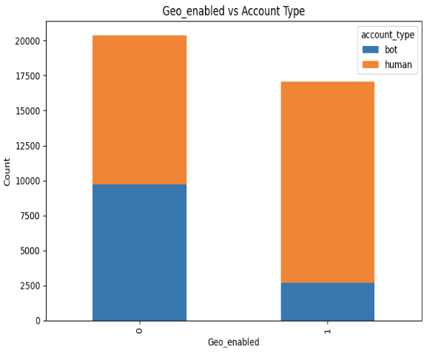
Data Exploration: Boolean Features
Transformation to Numeric: Converted boolean features to numerical values (0 and 1) to make them compatible with machine learning models.
Chi-Square Test: Conducted chi-square tests on each boolean feature (default_description, default_profile, default_profile_image, geo_enabled, and verified) to determine their statistical relationship with the target variable (account_type). All p-values were very small (p < 0.05), indicating significant relationships between these features and the target variable.
Notes:
Distributions: The bar charts help to visualize the differences in the distribution of boolean features between human and bot accounts. For example, accounts with a default_description are more likely to be bots.
Chi-Square Test: The chi-square test was performed to assess whether each boolean feature was significantly associated with the target variable (account_type). A significant result implies that the feature is informative and likely useful for model differentiation between humans and bots.

Slide 7
Data Exploration: Categorical Features
Train-Test Split: Stratified
Unique Category Count: Show the number of unique categories for each feature. For lang, there are 49 unique values, while location has 12,049 unique values. Highlight the large variety in location compared to lang.
Handling Rare Categories: Group rare values in the location feature into a category labeled "Other" to prevent overfitting during target encoding. This helps reduce noise from categories with too few instances and makes the model more generalizable.
Features | Unique Count
lang | 49
location | 12049
Total 13179/37434 rare locations
Dataset | Shape of X | Shape of y
Training Set | (22,460, 12) | (22,460,)
Validation Set | (7,487, 12) | (7,487,)
Test Set | (7,487, 12) | (7,487,)
Notes:
Rationale for Grouping Rare Categories: Rare categories can lead to unreliable encoded values, especially when using target encoding, as they are heavily influenced by individual data points. By grouping them into "Other," we reduce the risk of overfitting and improve model stability.
Rationale for Train-Test Split: The stratified split helps maintain the class distribution across all sets, ensuring consistent performance evaluation.

Slide 8
Data Preprocessing: Scaling & Target Encoding
Numerical Features - Scaling:
Used StandardScaler from sklearn.preprocessing to scale numerical features (log_favourites_count, log_followers_count, log_friends_count, log_average_tweets_per_day, account_age_days).
Scaling was done to normalize the data, ensuring that features have similar scales, which is particularly important for models sensitive to feature magnitude differences.
  Training and Test Set: The scaler was fitted on the training set and then used to transform both the training and test sets. This ensures that information from the test set does not leak into the training process.
Categorical Features - Encoding:
Used TargetEncoder from category_encoders to encode categorical features (lang, location).
Target encoding was chosen to create numerical representations of categorical features based on their relationship with the target variable.
  Training and Test Set: The target encoder was fitted on the training set with y_train and then used to transform both the training and test sets, maintaining consistency across datasets.
Notes:
Purpose of Preprocessing: Scaling and encoding are essential for improving the performance of machine learning models. Scaling helps in ensuring that numerical features contribute equally to the model, while encoding transforms categorical variables into a form that can be interpreted by the model, capturing their relationship with the target variable.

Slide 9
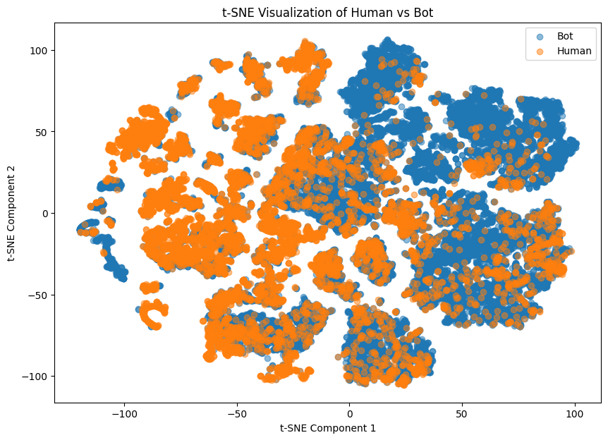
Machine Learning Techniques
Basic Model: Logistic Regression - baseline
Non-Linear Model:
  Support Vector Machine (SVM): Capable of capturing non-linear decision boundaries.
  Tree-Based Models: Random Forest, AdaBoost, XGBoost - Useful for capturing non-linear relationships.
  Neural Networks: Suitable for capturing complex patterns in the data.
Other Techniques: Consider using methods like balanced weights to handle the imbalanced dataset.
Evaluation Metrics: Metrics to evaluate model performance include AUC/ROC, Precision, Recall, and F1-score.
Notes:
Model Selection Rationale: Based on the t-SNE visualization, the data has clusters that suggest a non-linear decision boundary, making models like SVM, tree-based models, and neural networks suitable for capturing these patterns.
Handling Imbalanced Data: Due to the class imbalance between human and bot accounts, techniques like using balanced weights in models could help improve model performance.
Evaluation Metrics: Given the imbalanced nature of the dataset, AUC/ROC is an appropriate metric as it evaluates the model's ability to distinguish between classes. Additionally, precision, recall, and F1-score are crucial for understanding the trade-offs between false positives and false negatives, particularly important in distinguishing bots from human accounts.

